Slide 1


Irradiation of Gastrointestinal Cancers
Alexandr Pankratov
Centre of Oncology and Radiotherapy "PET-Technology Balashikha" Ltd. ,
Balashikha, Moscow Region, Russia
Istanbul, 18-21 of December 2023

Slide 2
Cancers of the Digestive System
Esophageal
Stomach
Pancreas
Liver malignancy (Hepatocellular Ca, mts)
Gall blader
Bile Duct
Rectal
Anal
Lymph node SBRT

Slide 3
Esophageal Cancer
Esophageal cancer is an extremely aggressive, lethal malignancy that is increasing in incidence worldwide, 5-10 per 100,000

Slide 4
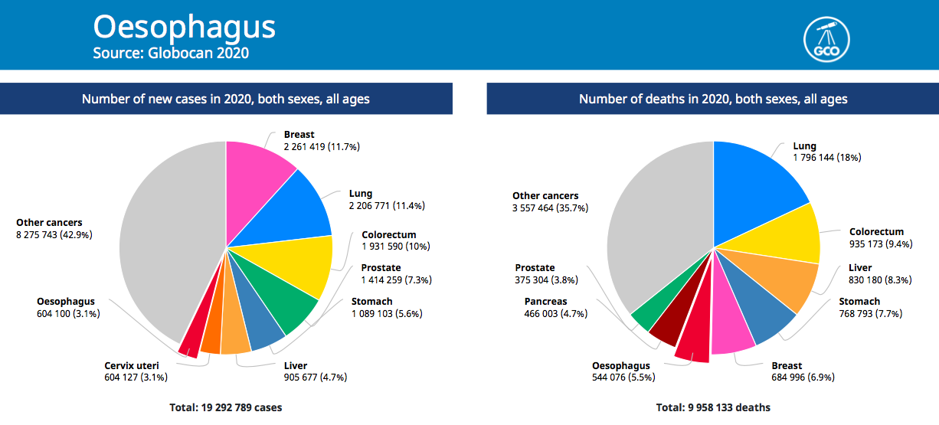
Prevalence – 8th position,
Mortality – 6th among other types of cancer

Slide 5
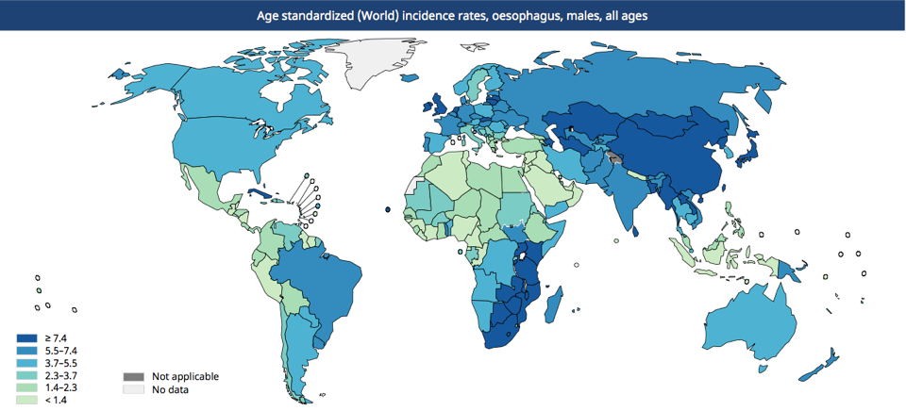

(SCC)
(AC)
(AC)
(SCC)
Esophageal cancer belt
(SCC)
(AC)
International Agency for Research on Cancer 2020

Slide 6
Squamous cell carcinoma 28 - 90%
Adenocarcinoma 10% - 70%

Slide 7
Neoadjuvant chemoradiotherapy followed by surgery is the standard treatment for patients with esophageal cancer.

Slide 8
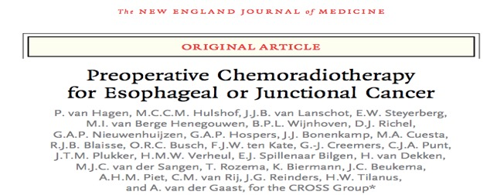
368 patients
adenocarcinoma 75%
squamous-cell carcinoma 23%
large-cell undifferentiated carcinoma 2%
CRT followed by Surgery 178
Surgery alone 188
R0: CRT+S = 92%
Surgery = 69%
N Engl J Med 2012;366:2074-84.

Slide 9
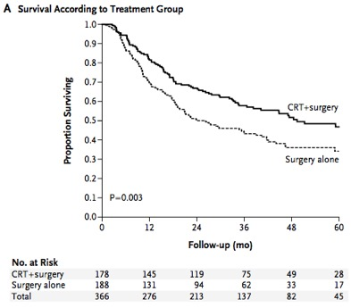
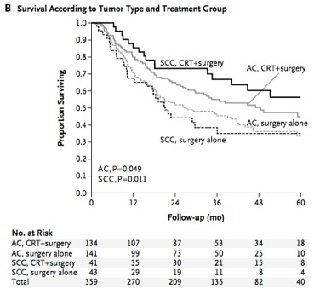
Preop. CRT + Surg. vs. Surg. only
OS: Preop. CRT + Surg. = 49.4 months
Surg. only = 24.0 months
N Engl J Med 2012;366:2074-84.

Slide 10
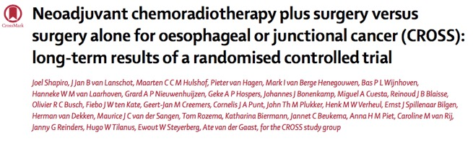
Long-term follow-up confirms the overall survival benefits for neoadjuvant chemoradiotherapy when added to surgery in patients with resectable oesophageal or oesophagogastric junctional cancer.
 | CRT + Surg. | Surg. only
SCC | 81.6 mon. | 21.1 mon
ACA | 43.2 mon. | 27.1 mon
OS:
Lancet Oncol 2015; 16: 1090–98

Slide 11
However, most patients (or doctors?) in some countries generally prefer surgery to neoadjuvant therapy as their initial therapeutic strategy.

Slide 12
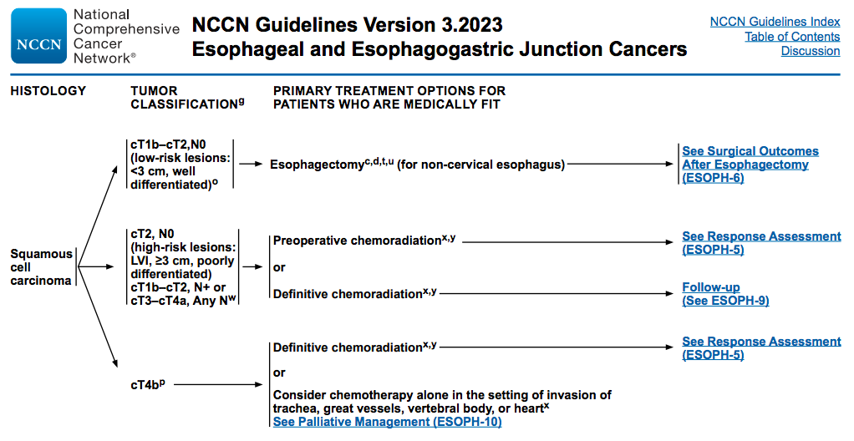
Primary treatment options: SCC
NCCN 2.2018

Slide 13
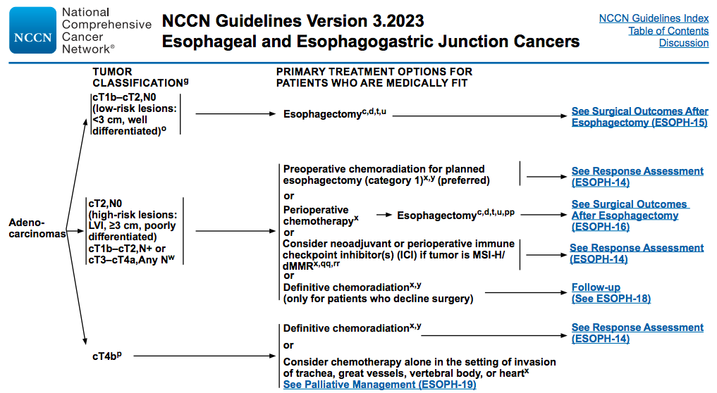
Primary treatment options: ACA

Slide 14
Preoperative chemoradiation:
(more often)
RT 41.4-50.4Gy + concurent chemotherapy
Paclitaxel 50mg/m2 + Carboplatin AUC 2
weekly
NCCN 3.2023

Slide 15
Postoperative chemoradiation:
(not for all cases)
RT 45-50.4Gy + concurent chemotherapy
Fluorouracil 200-250mg/m2 days 1-5
NCCN 3.2023

Slide 16
Definitive chemoradiation:
(for locally advanced inoperable EC)
RT 50-50.4Gy + concurent chemotherapy
Cisplatin 75-100mg/m2
Fluorouracil 750-1000mg/m2 days 1-5
NCCN 3.2023

Slide 17
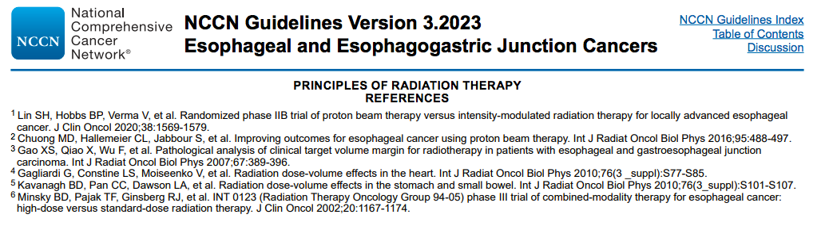
Recommendations for dosing based on the INT 0123 trial (RTOG 9405), in which dose escalation from 50.4 to 64.8Gy did not increase OS
Minsky BD et al., J Clin Oncol. 2002;20(5):1167–1174.

Slide 18
The some studies indicate that a higher radiation dose could improve local tumor control, and may also confer survival benefits.

Slide 19
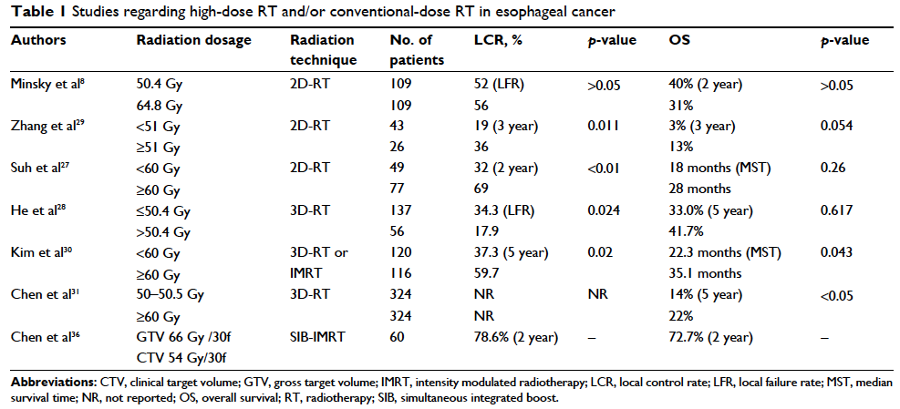
Studies regarding high-dose RT and/or conventional-dose RT in esophageal cancer
Luo et al., Cancer Management and Research 2018:10

Slide 20
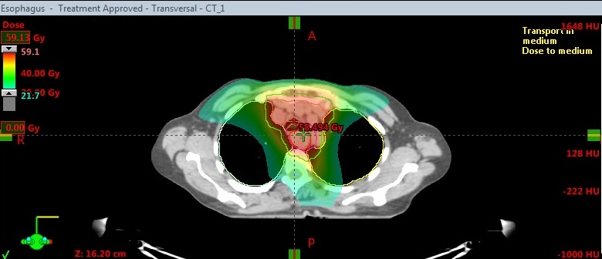

Case: a 65 year old woman, ЕSCC cT3N2M0
Upper and middle thirds of the esophagus
PET
Technology

Slide 21
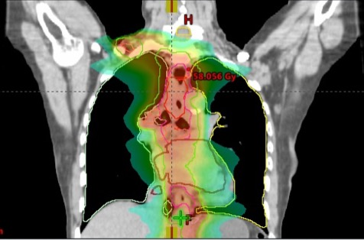
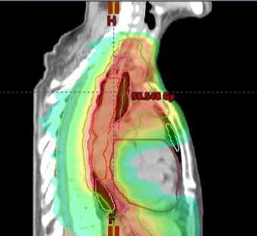
Case: a 65 year old woman, ЕSCC cT3N2M0
Upper and middle thirds of the esophagus
PET
Technology

Slide 22
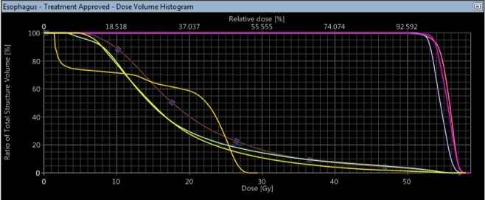

Case: a 65 year old woman, ЕSCC cT3N2M0
Upper and middle thirds of the esophagus
VMAT 54 Gy + 5FU
PET
Technology

Slide 23
Conclusion
Preoperative chemoradiotherapy improved survival among patients with potentially curable esophageal or esophagogastric-junction cancer.
The standard RT dose (50.4 Gy in 28 fractions) may be inadequate to achieve a high probability for LC for some subgroup patients.
3. The some studies indicate that a higher radiation dose could
improve local tumor control, and may also confer survival benefits.
4. The course of radiation therapy should be without interruptions.

Slide 24
Gastric cancer

Slide 25
Incidence
Highest: up to 69 cases per 100 000 people per year –
in northeast Asia (Japan, Korea, and China)
Intermediate: in Europe and South America
Low: rates of 4–10 cases per 100 000 people - in North America, Africa, south Asia, and Oceania (including Australia and New Zealand)
Yamaoka Y, Kato M, Asaka M., Intern Med 2008; 47: 1077–83.

Slide 26
Gastric cancer
Surgical resection of the primary tumor and regional lymph nodes is the treatment of choice for gastric cancer.
What should be next?

Slide 27
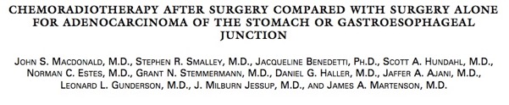
Surgery plus chemoradiotherapy vs Surgery only
556 patients – total (adenocarcinoma):
275 pts. – surgery only
281 pts. – surgery plus chemoradiotherapy
T1-4; N0-3
fluorouracil 400mg/m2
leucovorin 20mg/m2
CRT: 45Gy/25fr. +
N Engl J Med, Vol. 345, 2001

Slide 28
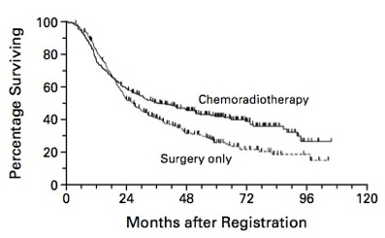
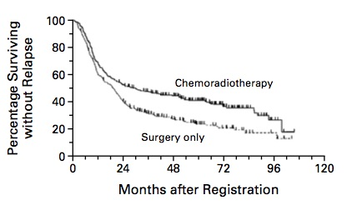
Results
OS
RFS
Surgery – 27 mon.
S.+ CRT – 36 mon.
Surgery – 19 mon.
S.+ CRT – 30 mon.
for all stages
N Engl J Med, Vol. 345, 2001

Slide 29
Risk factors:
Lymphatic, venous, or perineural invasion
Positive surgical resection margin
Lesion in the whole stomach
Large number positive lymph. nodes
Lymph node dissection < then D2

Slide 30
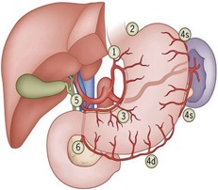
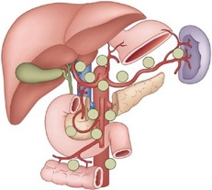
Lymph Nodes Groups Surrounding the Stomach
Right cardial nodes
Left cardial nodes
Nodes along the lesser curvature
Nodes along the greater curvature
Suprapyloric nodes
Infrapyloric nodes
Nodes along left gastric artery
Nodes along the common hepatic artery
Nodes along the celiac axis
Nodes at the splenic hilus
Nodes along the splenic artery
Nodes in the hepatoduodenal ligament
Nodes at the posterior aspect of pancreatic head
Nodes at the root of the mesenterium
Nodes in the mesocolon of the transverse colon
Para-aortic lymph nodes
Hartgrink HH, Van De Velde CJH (2005) J Surg Oncol 90:153–165

Slide 31
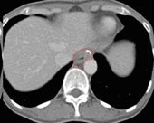
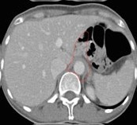
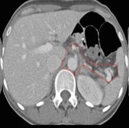
CTV for T1N1M0 adenocarcinoma of the gastric cardia post-total gastrectomy
Coverage of celiac artery
Coverage of esophagojenunal anastomosis
Coverage of hepatogastric ligament
Coverage of splenic hilum
N.Y.Lee, 2013

Slide 32
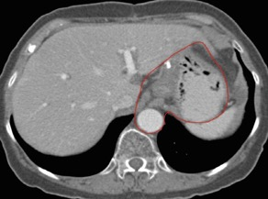
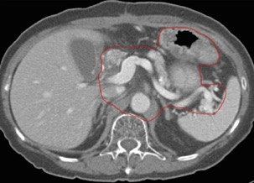
CTV of T3N3M0 adenocarcinoma of the gastric body post-distal gastrectomy
Coverage of gastrojejunal anastomosis
Coverage of Celiac artery
Coverage of splenic hilum
Coverage of remnant stomach
N.Y.Lee, 2013

Slide 33
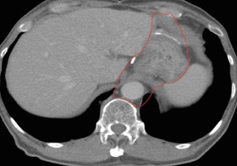
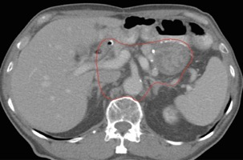
CTV of T2N1M0 adenocarcinoma of the antrum/pylorus post-distal gastrectomy
Coverage of hepatogastric ligament, gastrojejunal anastomosis
Coverage of duodenal stump
Optional coverage of splenic hilum
Coverage of remnant stomach
N.Y.Lee, 2013

Slide 34
Radiotherapy
RT Dosing (1.8Gy/d):
R0: 45-50.4 Gy
R1-2: 59.4-61.2 Gy (boost)
Lymph nodes:
Proximal 1/3: perigastric, celiac, left gastric artery, splenic artery, splenic hilar, hepatic artery, and porta hepatic lymph nodes.
Middle 1/3: perigastric, celiac, left gastric artery, splenic artery, splenic hilar, hepatic artery, porta hepatic, suprapyloric, subpyloric, and pancreaticoduodenal lymph nodes.
Distal 1/3: perigastric, left gastric artery, celiac, hepatic artery, porta hepatic, suprapyloric, subpyloric, and pancreaticoduodenal lymph nodes.
Empty Stomach
Dose constraints:
Lung V20Gy<30%, Dmean<20Gy;
Heart V30Gy<30%, Dmean<30%;
Kidney V20Gy<33%, Dmean<18Gy;
Liver V30Gy <33%, Dmean<25Gy;
Bowel V45Gy<195cc;
Spinal cord Dmax<45Gy.
Tepper JE, Gunderson LE. Semin Radiat Oncol 2002;12:187-195.

Slide 35
Conclusion
Postoperative chemoradiotherapy should be considered for all patients at high risk for recurrence of adenocarcinoma of the stomach or gastroesophageal junction who have undergone curative resection.

Slide 36
Rectal cancer
Current standard of neoadjuvant treatment for locally advanced rectal cancer (cT3-4 and/or cN+) is either the use of preoperative short-course radiotherapy (5 x 5 Gy) or preoperative, conventionally fractionated radiotherapy with continuous infusion 5-FU or oral capecitabine, followed by total mesorectal
excision surgery six weeks there after.

Slide 37
12 trials were included in metaanalyses.
Surgical Oncology 23 (2014)

Slide 38
Conclusion
SCRT with immediate surgery is as effective as LCRT with delayed surgery for treatment of rectal cancer in terms of OS, DFS, LRR, DMR, Sphincter preservation rate, R0 resection rate and late toxicity.
Though LCRT increased pathologic complete response (pCR) rate, LCRT also increased acute toxicity compared with SCRT.
SCRT is a better choice in centers with a long waiting list or lack of medical resources.

Slide 39
515 patients
261 in the short-course/CCT
254 in the chemoradiation
Annals of Oncology 0: 1–6, 2019

Slide 40
Long-course vs 5x5 Gy
The superiority of preoperative short-course/CCT over
chemoradiation was not demonstrated.
Annals of Oncology 0: 1–6, 2019

Slide 41
Our experience
Preoperative CRT
Dose 2Gy/25fx/50Gy
CBCT for each fraction

Slide 42
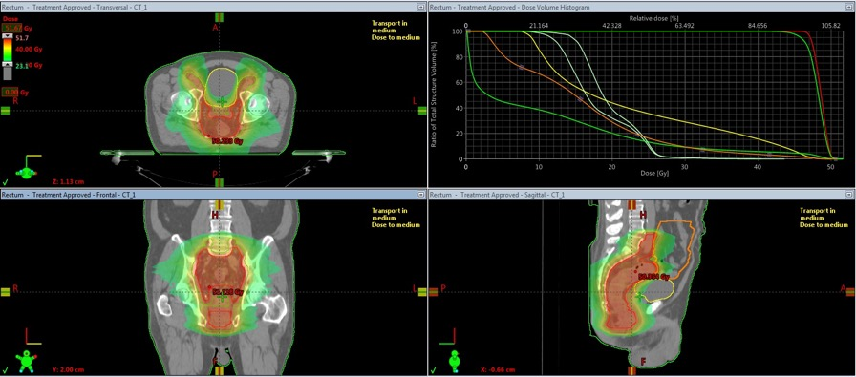
Case: men 56 y.o., AC cT3N1M0
PET
Technology

Slide 43
General Conclusion
In the treatment of gastrointestinal tract cancers the stereotactic techniques may be important in delivery high doses of radiation per fraction or per course.

Slide 44

Thank you so much!

